Slide 1
How To Schedule An Appointment
with the Academic Support Center

Slide 2
How To Schedule An Appointment
Appointments can be made through our online scheduling Platform, WC Online, or by calling the ASC to make an appointment.
East Peoria (309) 694-5768
Peoria (309) 690-6833
The schedule ranges from March 18th – April 6th (Monday – Saturday)
If you would like to meet virtually, please select “Yes, Schedule Online Appointment” when completing the appointment questionnaire.
Take note of the location of the tutor when scheduling the appointment. We have options available at both campuses and online.

Slide 3
Virtual Only | In-Person Only | Virtual & In-Person
Danette B. | Tomas F. | Nyrobi W.
 |  | Sierra D.
 |  | Synthia D.
 |  | Manny C.

Slide 4
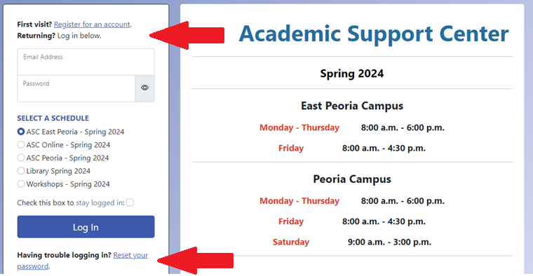
How To Create An Account With WC Online
If you do not already have an account with the ASC, you will need to first create one using your:
ICC Student Email Address
Full Name
Student ID Number.
Before logging in, select the “CRJ – Dr. Anthony White” schedule.
https://icc.mywconline.com/

Slide 5
How To Select An Appointment Slot
The day of the week can be found on the left-hand side. Along with the tutor’s name and location.
You can find future appointments by selecting “Next Week”.
The white boxes are available appointments to meet with an ASC tutor.

Slide 6
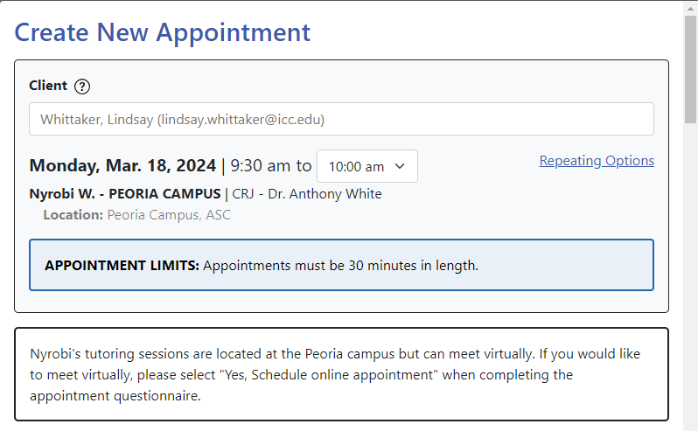
Create New Appointment
Select the day and time you would like to reserve.
You will be directed to complete the “Create New Appointment” questionnaire.
If you would like an online appointment, please select “Yes, Schedule Online Appointment”.
Once you have completed all the necessary fields, select “Create Appointment”.
Depending on your communication preferences, you will receive a confirmation email with your appointment date and time.

Slide 7
East Peoria Campus: Administrative Building, L312, Library Balcony
Peoria Campus:
Student Center, S210
Online:
You will receive a Zoom link from your tutor before your appointment.

